Slide 3
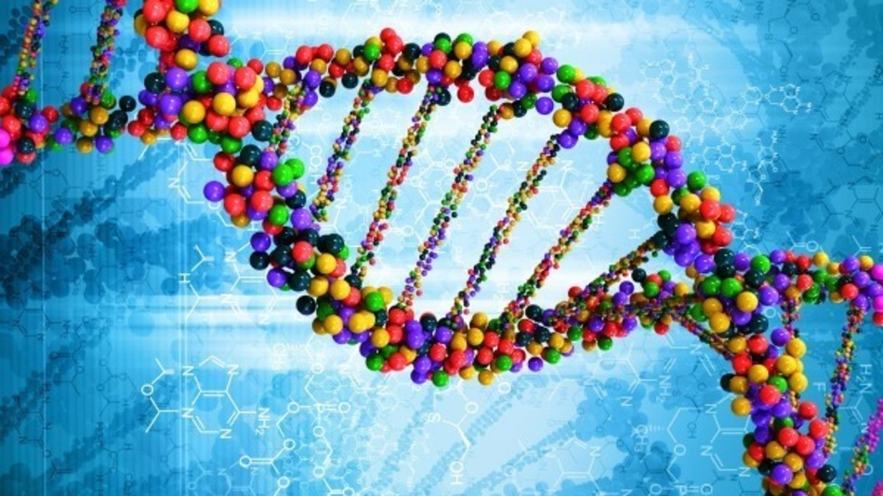
First Things First
Chromosomes are made up of DNA
DNA stands for Deoxyribonucleic Acid

Slide 4
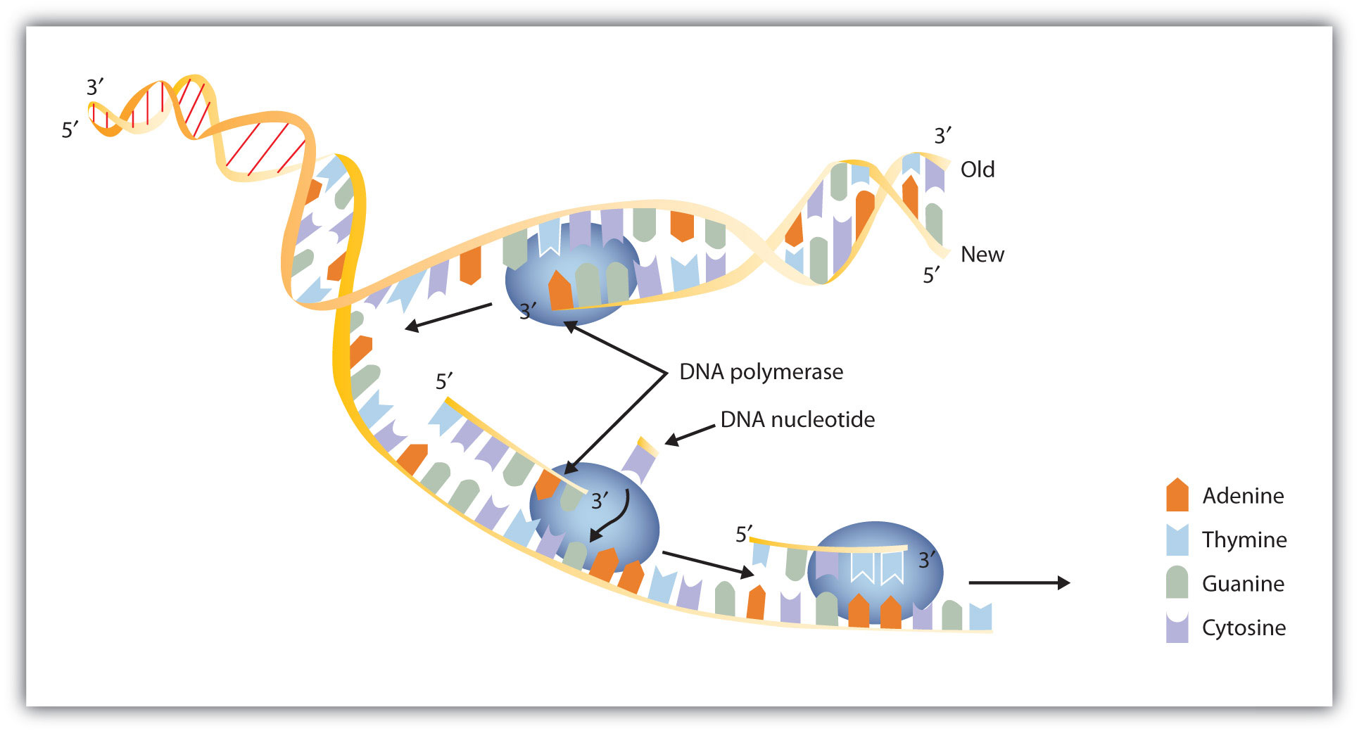
First Things First
First it must be able to give instructions for building and maintaining cells.
Second, it must be able to be copied each time a cell divides.

Slide 5
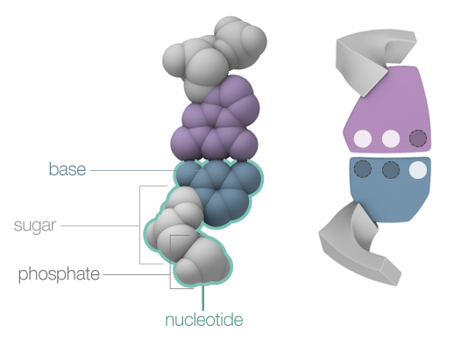
What’s it made of ?
A nucleotide consists of a sugar, a phosphate, and a base.

Slide 6
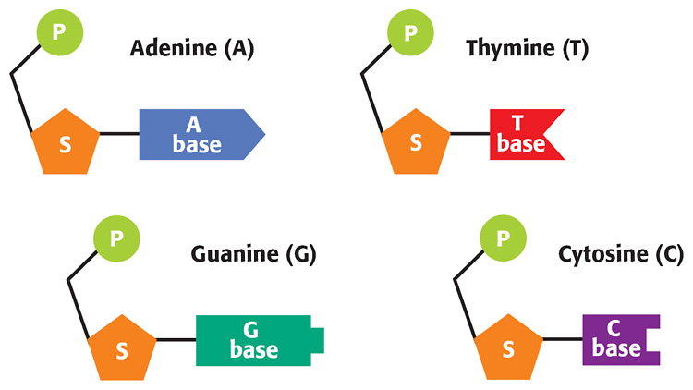
What’s it made of?
The Four nucleotides include:
Adenine
Thymine
Cytosine
Guanine

Slide 7
Discovery of DNA
In the 1950s, a biochemist named Erwin Chargaff found that the amount of adenine in DNA always equals the amount of thymine.

Slide 8
Discovery of DNA
And he found that the amount of guanine always equals the amount of cytosine.

Slide 9
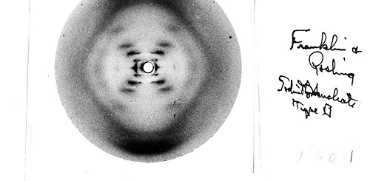
Discovery of DNA
Rosalind Franklin, a chemist, was able to make the first images of DNA molecules. She used a process known as X-ray diffraction to make these images.

Slide 10
Discovery of DNA
At about the same time, two other scientists were also trying to solve the mystery of DNA’s structure. They were James Watson and Francis Crick. After seeing Franklin’s X-ray images, Watson and Crick concluded that DNA must look like a long, twisted ladder. They were then able to build a model of DNA by using simple materials from their laboratory. Their model perfectly fit with both Chargaff’s and Franklin’s findings. The model eventually helped explain how DNA is copied and how it functions in the cell.

Slide 11
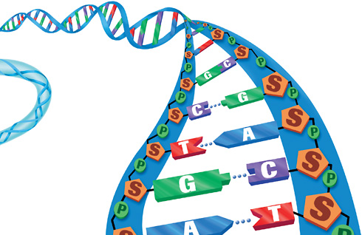
Structure of DNA
The shape of DNA is shown in Figure 4. As you can see, a strand of DNA looks like a twisted ladder. This shape is known as a double helix

Slide 12
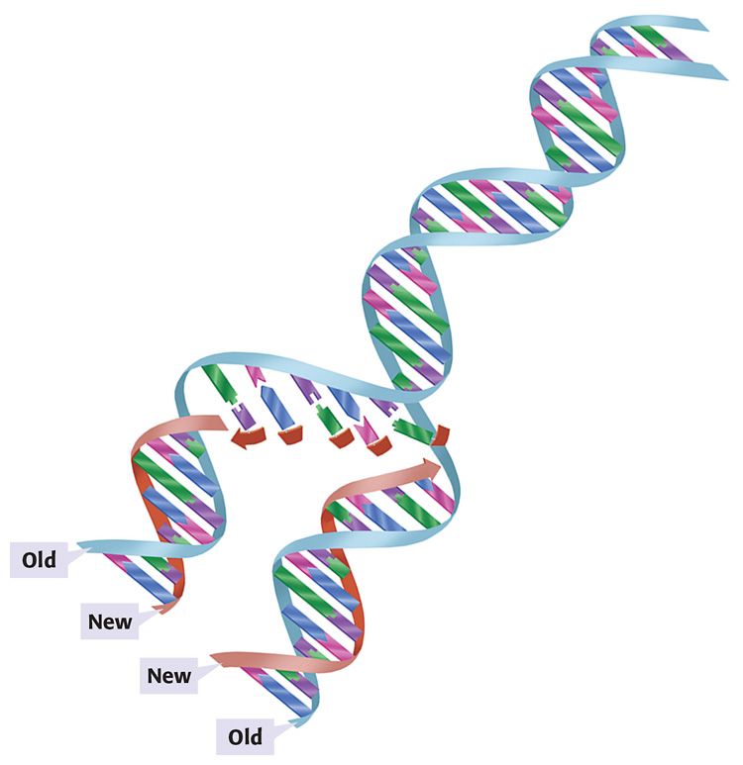
Replication of DNA
During replication, a DNA molecule is split down the middle, where the bases meet.
The bases on each side of the molecule are used as a pattern for a new strand.

Slide 13
Replication of DNA
As the bases on the original molecule are exposed, complementary nucleotides are added to each side of the ladder. Two DNA molecules are formed. Half of each of the molecules is old DNA, and half is new DNA.

Slide 14
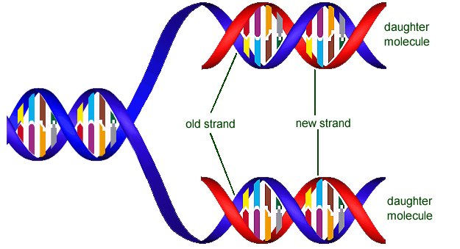
DNA is copied every time a cell divides.
Each new cell gets a complete copy of all the DNA.
The job of unwinding, copying, and re-winding the DNA is done by proteins within the cell.

Slide 15
learn.genetics.utah.edu/content/molecules/builddna/
http://kmusto.weebly.com/dna.html

