Slide 1
The excretory System

Slide 2
What is excretion?
Excretion is the process of eliminating waste.
There are several systems within our bodies that help us to eliminate waste products.
    Excretory (Urinary) – eliminates liquid waste
    Digestive- disposes of solid waste products from food
    Integumentary (skin)- releases waste through sweat glands
    Respiratory- disposes of water vapor and waste gases (CO₂) from the blood

Slide 3
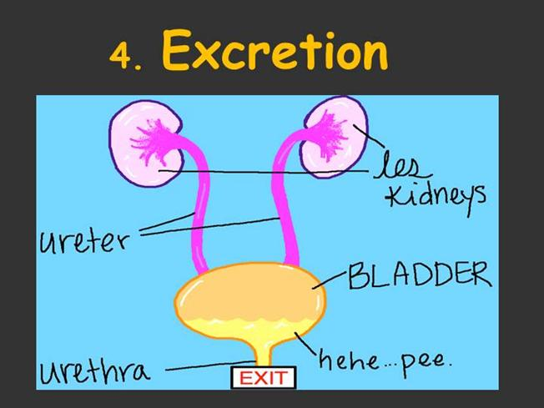
Function of the Excretory System
The main function of the excretory system is to filter out cellular wastes, toxins, and excess water from the blood.
The structures of the urinary system act as filters to help keep the blood clean.
There are five important structures: kidneys, nephrons, ureters, bladder, and the urethra.

Slide 4
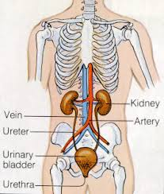
Excretory Organs

Slide 5
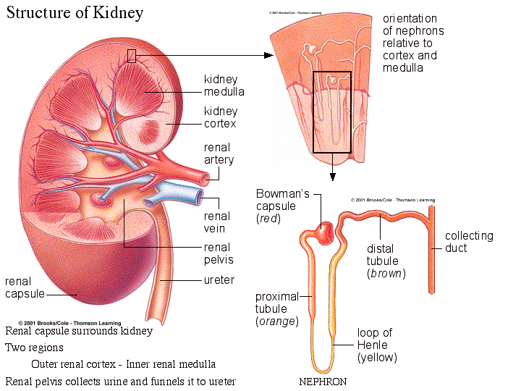
Kidneys
The two kidneys get rid of urea, excess water, and some other waste materials released by the cells.
These are eliminated as urine.

Slide 6
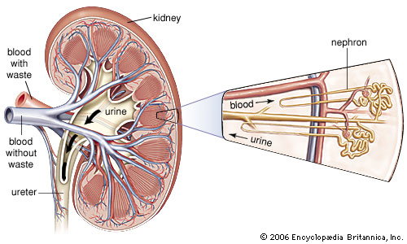
Nephrons
Nephrons - microscopic filters in the kidney that remove wastes (urea) from the blood.

Slide 7
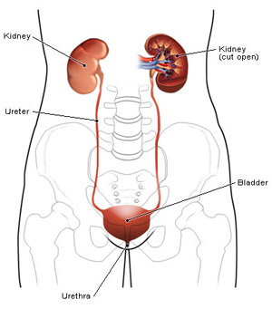
Ureters
Tubes which connect each kidney to the bladder

Slide 8
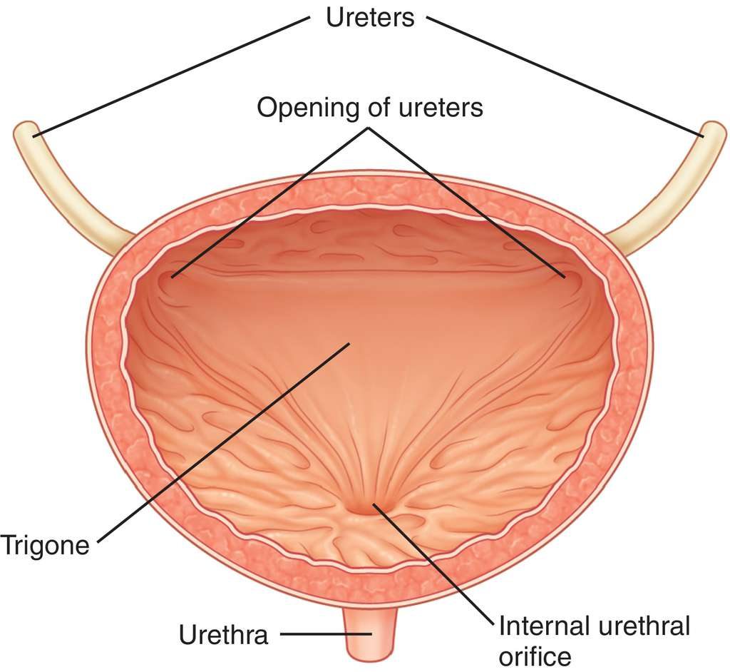
Bladder
A saclike muscular organ which stores urine until it is released from the body
Which type of muscle tissue is inside the wall of the bladder?

Slide 9
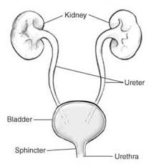
Urethra
Tube through which urine passes before it is removed from the body
Do you think there are voluntary or involuntary muscles at one end of the bladder? Why?

Slide 10
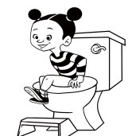
What happens when you tinkle?
Voluntary muscles at one end of the bladder allow a person to hold the urethra closed until he is ready to release the muscles.
At that time, the bladder contracts and sends the liquid waste out of the body!

